Slide 1
THE OPTICAL SIGNATURES OF CLIMATE CHANGE
IMPACTS ON PHYTOPLANKTON

Slide 2
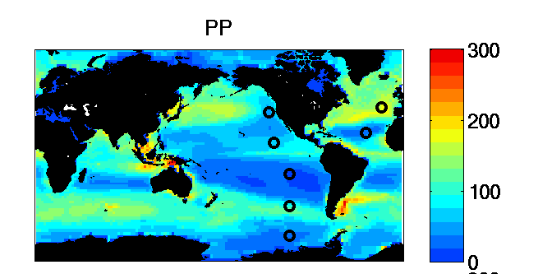
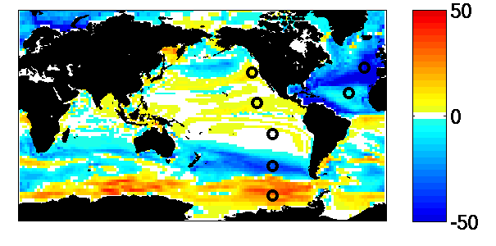
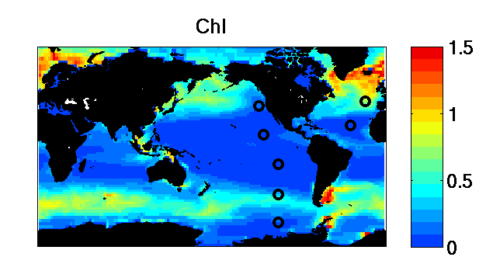
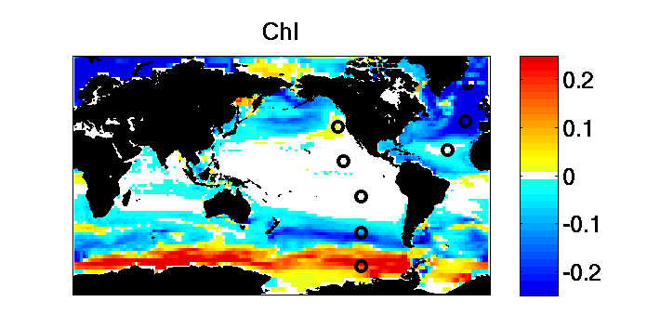
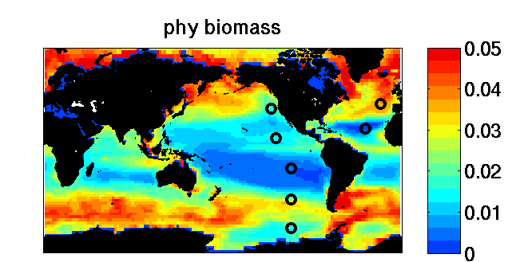
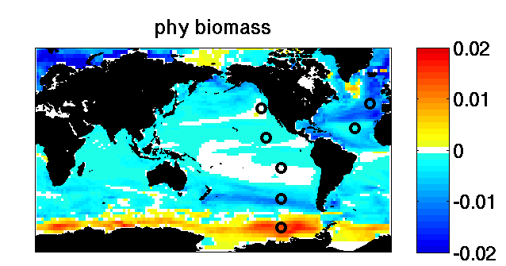
2000
Difference (2100-2000)
7
2
6
1
5
3
4
5 year averages

Slide 3
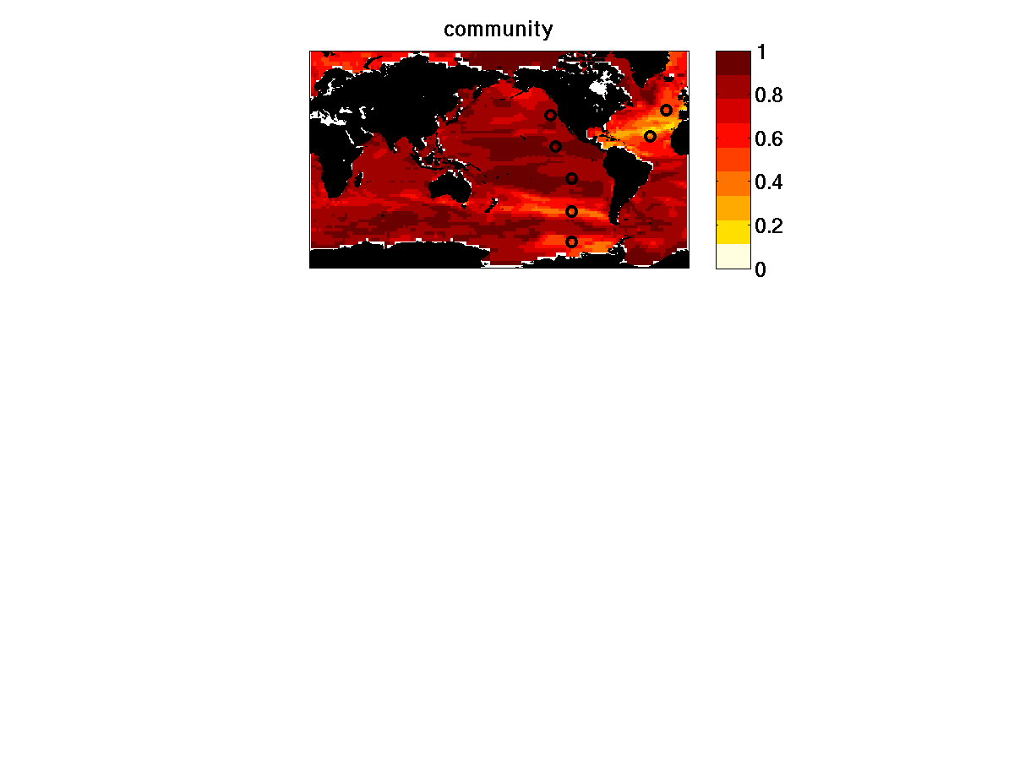
Amount of pre-industrial community still in any location in year 2100
(1=all community still there, 0=none of community there)
New community can have invaded – so does not imply decrease in biomass
F_{k} is biomass of each phytoplankton type
5 year averages

Slide 4
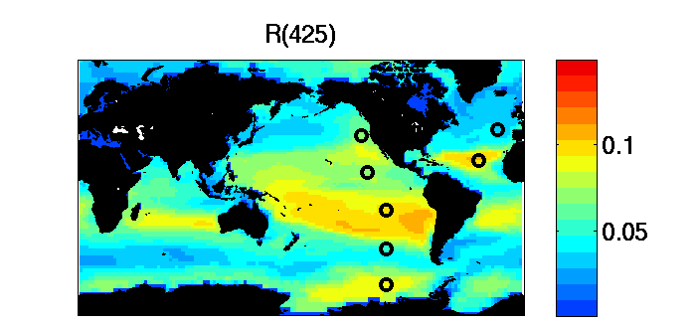
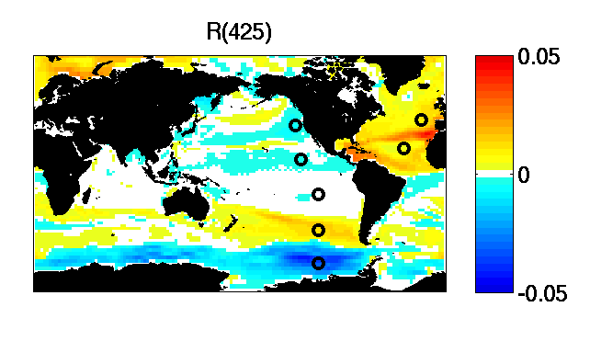
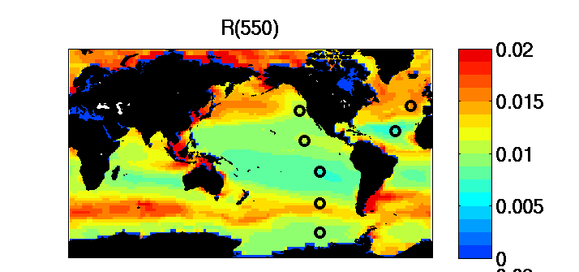
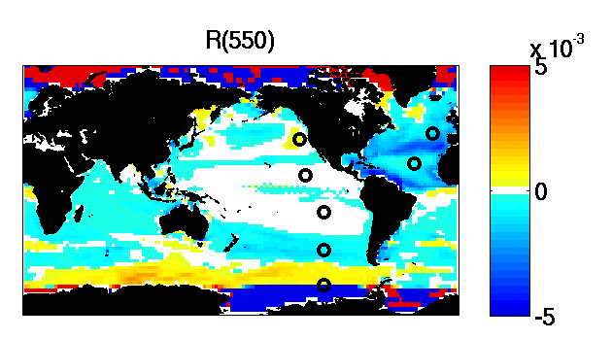
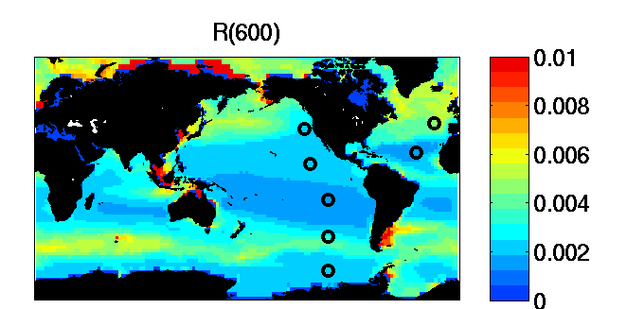
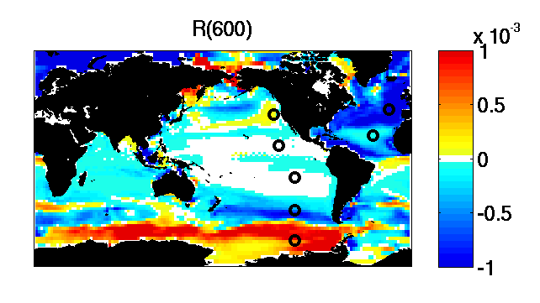
2000
Difference (2100-2000)
5 year averages

Slide 5
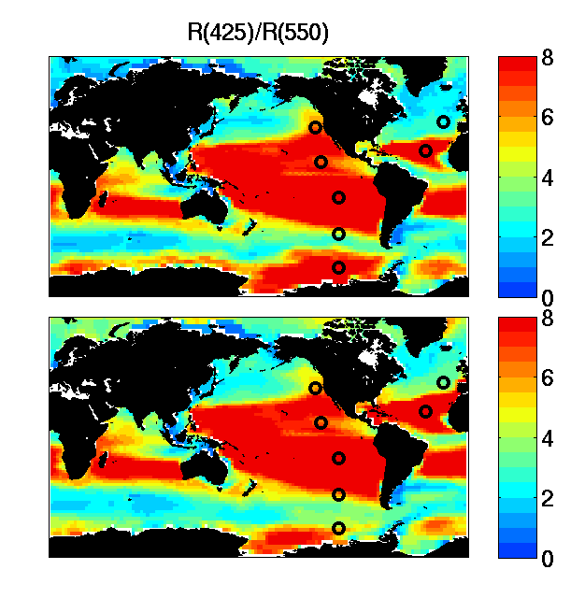
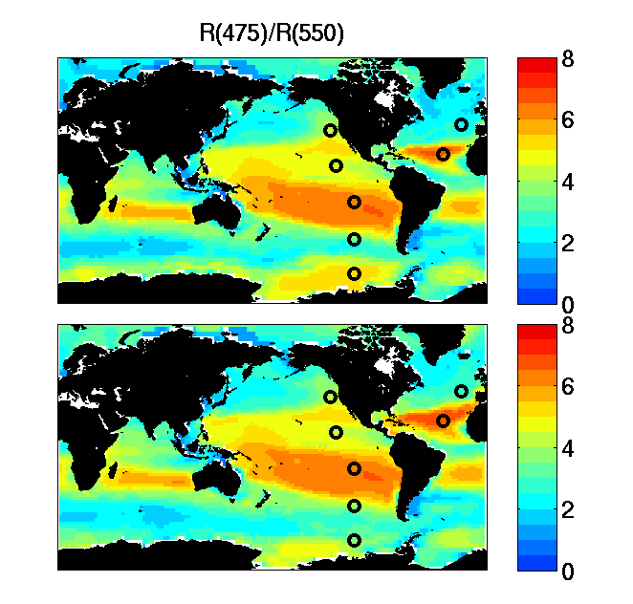
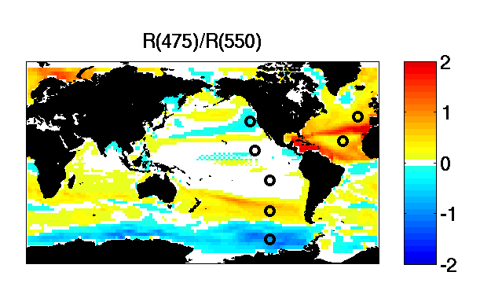
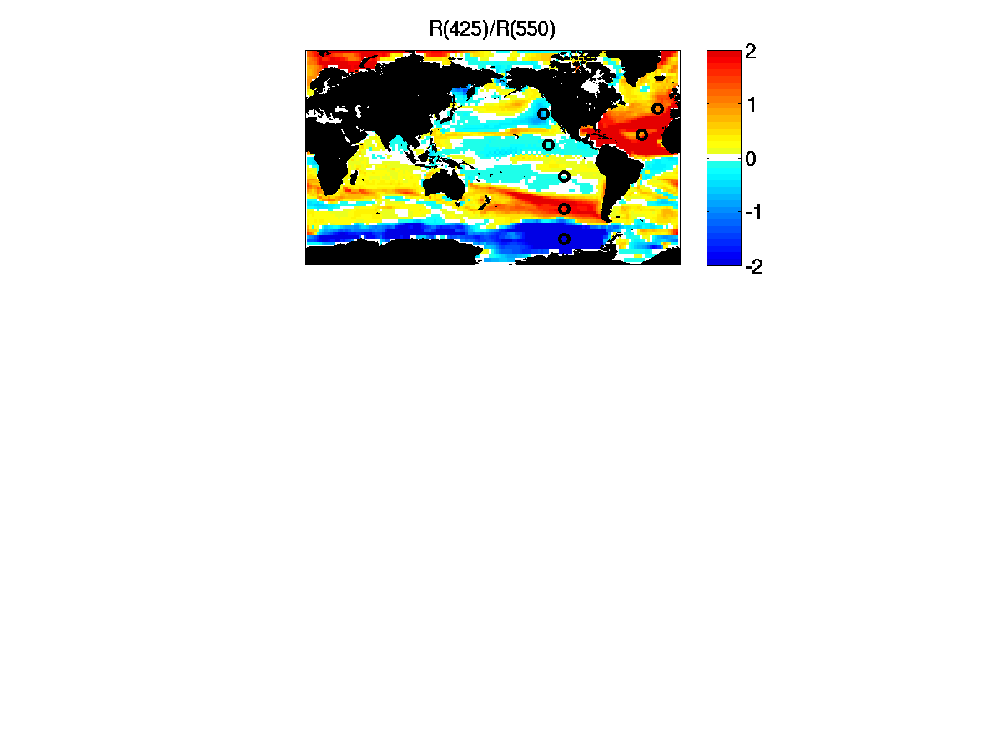
Difference (2100-2000)
5 year averages

Slide 6
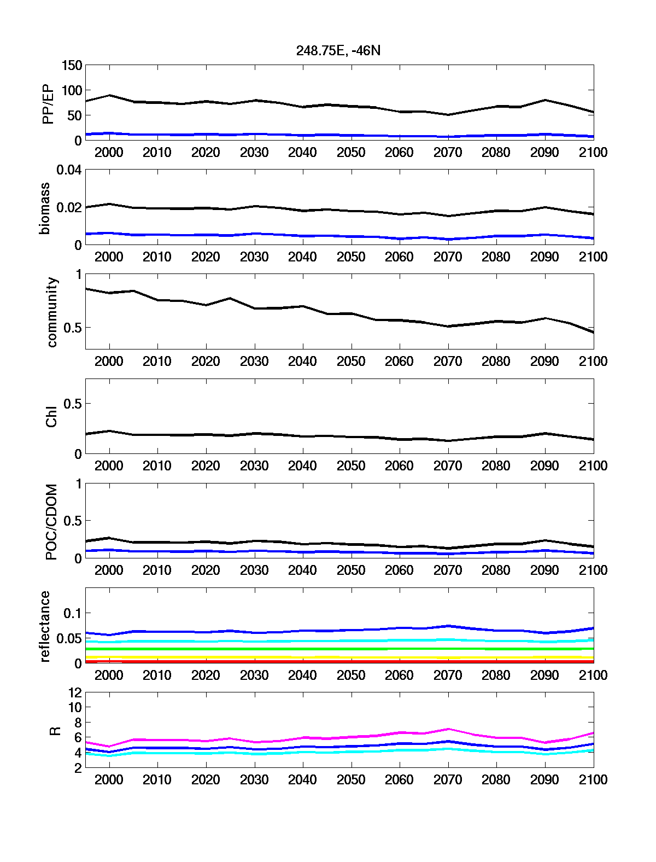
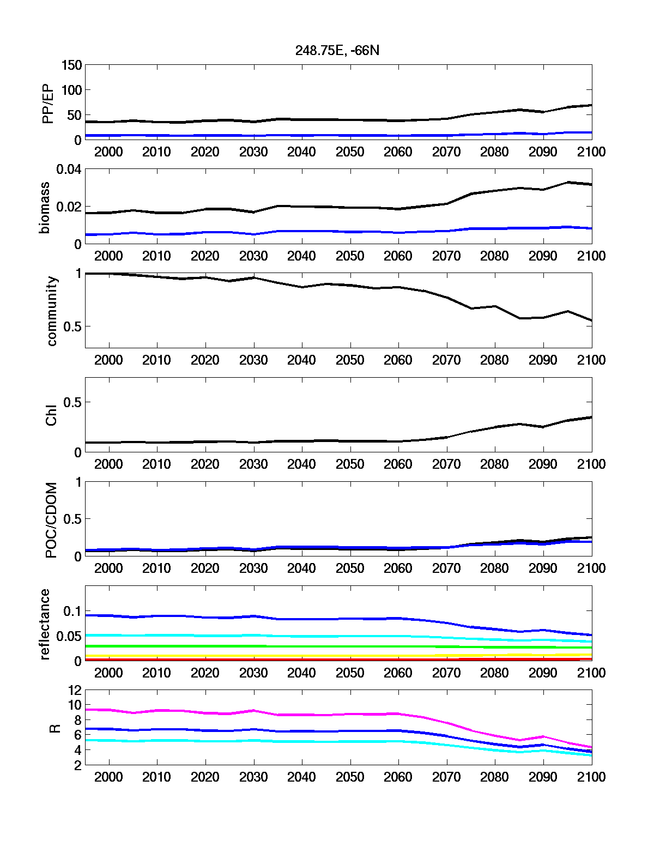
THE OPTICAL SIGNATURES OF CLIMATE CHANGE
IMPACTS ON PHYTOPLANKTON
Difference in Primary Production
(2100-2000)
N Atlantic
S Ocean
425/550
450/550
475/550
Difference in Ratio of Reflectance (R(425)/R(550)
(2100-2000)
N Atlantic
S Ocean
5 year averages

Slide 7
Fraction of 2000 community remaining in 2100
N Atlantic
S Ocean
425/550
450/550
475/550
Difference in Ratio of Reflectance (R(425)/R(550)
(2100-2000)
N Atlantic
S Ocean
5 year averages

Slide 8
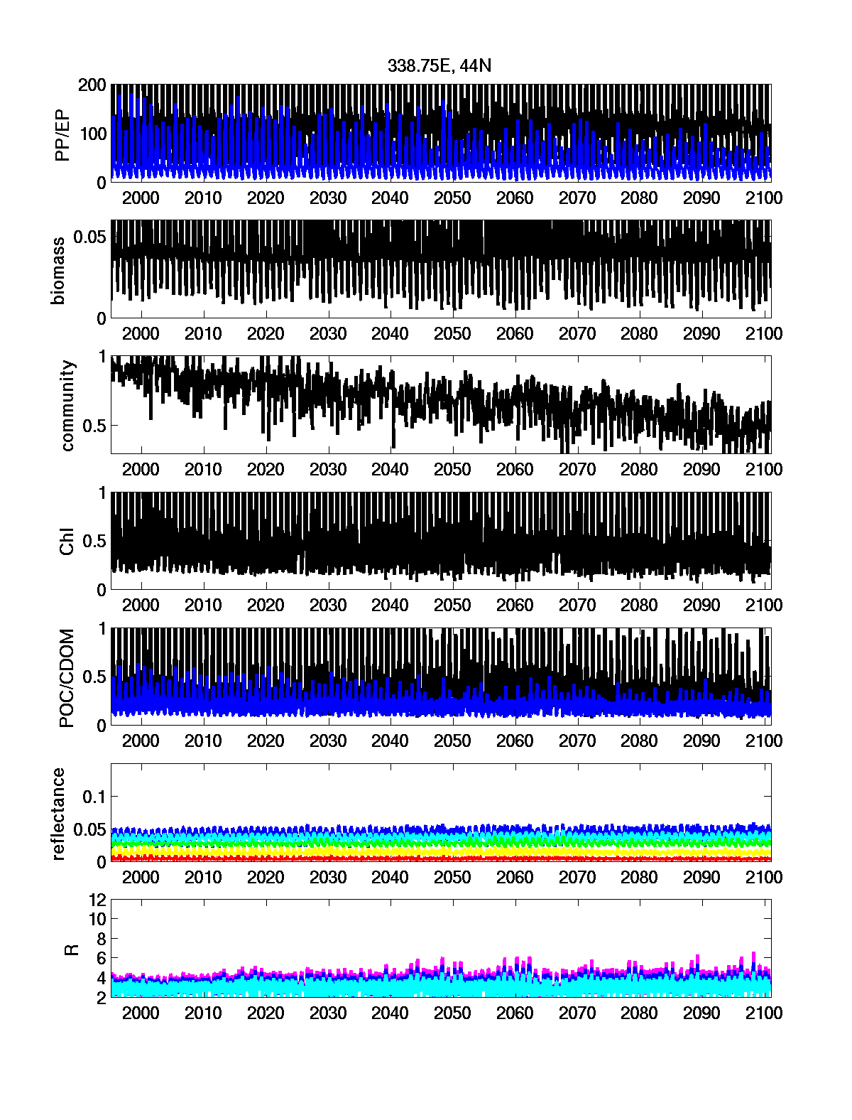
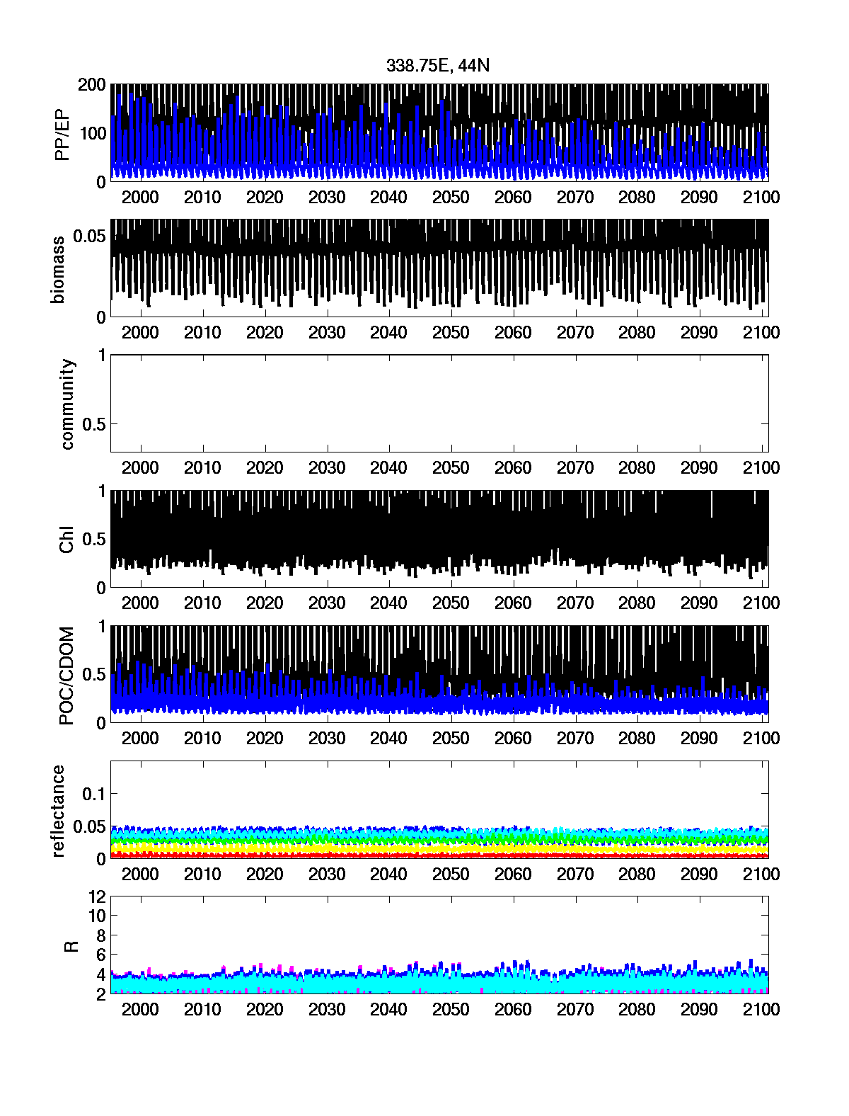
N Atlantic
425
475
500
550
600
425/550
450/550
475/550
TRANSIENT RUN: BUSINESS AS USUAL
CONTROL: PRE-INDUSTRIAL
monthly averages

Slide 9
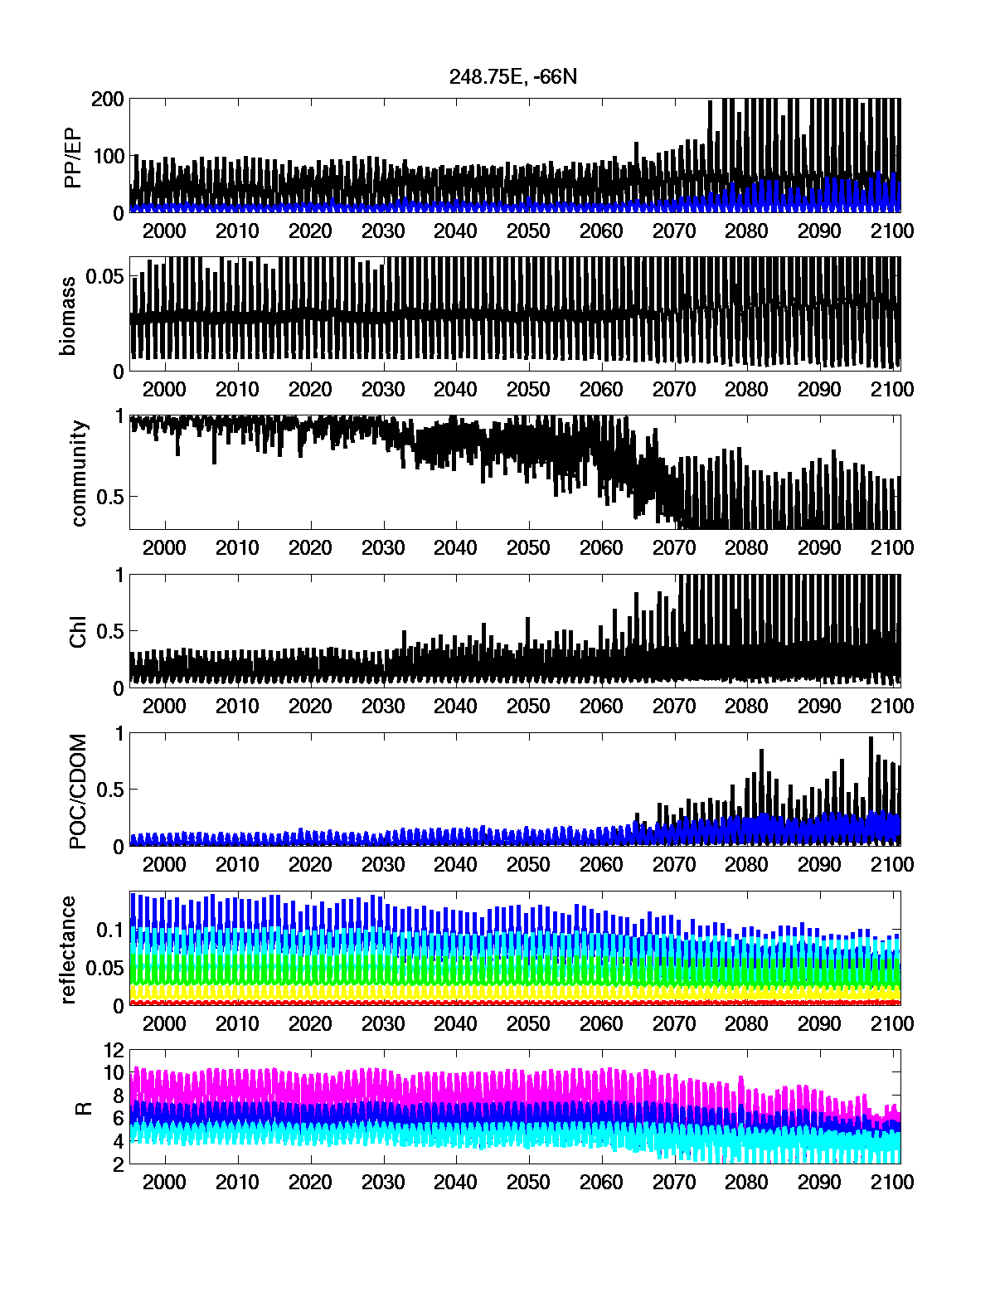
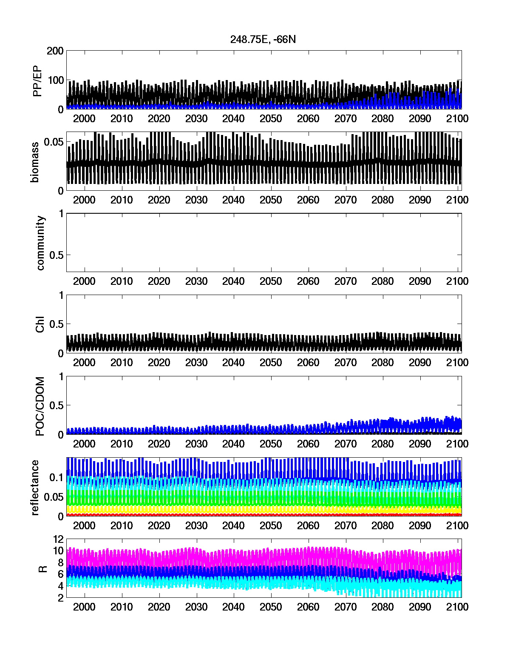
S Ocean
425
475
500
550
600
425/550
450/550
475/550
TRANSIENT RUN: BUSINESS AS USUAL
CONTROL: PRE-INDUSTRIAL
monthly averages

Slide 10
Question:
Are there optical signatures of community changes?
How to determine “trend” statistically : especially for non-linear changes?
Which regions have “trends” even in the control run?

